Slide 1

Video Game Sales
and Reviews
Are game sales affected by any of the dataset’s additional information?
Details to Analyze:
Does each region have video game preferences and do they change by year?
Do genres, ratings, or reviews included in the dataset correlate to video game profitability?
Does the popularity of the console/publisher/developer effect sales?

Slide 2


Introduction
Kurt Reinke
Paola Zihan Chao
Roma Patel
Wenxuan Gu
Dataset: CSV pulled from Kaggle comparing Video Games Sales by region to reviews, including various details of the games within the dataset
Excel Data includes:
Name|Platform|Release Date|Genre|Publisher|Developer|NA sales|EU Sales|JP Sales|Other Sales|Global Sales|Critic review scores|User review scores|Critic count|User count|Developer|Rating

Slide 3
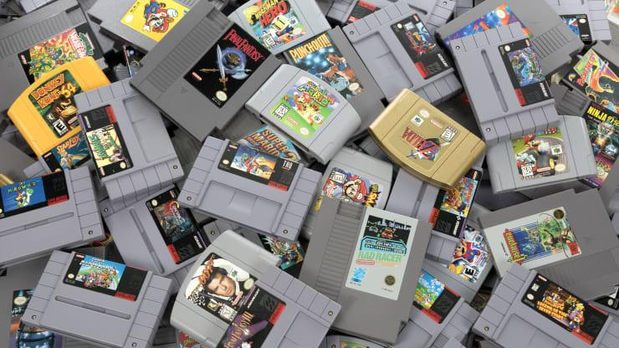
Questions
1. By year, which region bought the most video games? Did the region with the most video games sales also produce the most games?
2. Do regions prefer certain genres over others and more specifically does North America like shooting games more than other regions ? Does the rating(E, E10, T, M) or genre effect game sales?
3. Did positive critical and user reviews correlate to higher selling games?
4. Which platform had the most published games in comparison to total games sales and reviews. Did the popularity of the publisher/developer that created the game have an effect on the sales?

Slide 4

Limitations
The dataset tracks shipped games instead of sales, although the best measure of total sales of video games, this created some inaccurate data
Some outliers had hyper inflated sales because the game shipped with a console, including: Wii Sports
Games only released in one market make up 25% of the data, creating many games with zero sales in other regions
40% of the games are missing user/critical reviews and rating data
After 2010 because of the release of so many pc/mobile games and interest in these types of games increasing, sales seem to drop off because downloaded video games are not shipped

Slide 5
Video Game Sales by Region and Year
In 1984 there's the game named Duck Hunt which has 28.31 million sales
(count as 56.22% of that year sales)
In 1985 there's the game named Super Mario Bros. which has 40.24 million sales
(count as 74.6% of that year sales)
In 1989 there's the game named Tetris which has 30.26 million sales and the game named Super Mario Land which has 18.14 million sales
(both games count as 65.89% of that year sales)
On October 2000, Sony released PlayStation 2. This boosts video game sales up in 2001-2002.
On November 2004, Nintendo DS was released. On November 2005, Wii and XBox360 were released. On November 2006, PlayStation 3 was released. The releases of these 4 brand new and popular gaming platforms significantly boost the video game sales up from 2004 to 2008.

Slide 6
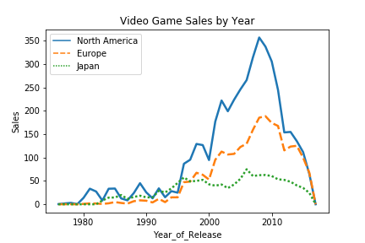
North America did the highest sales by year
Video game sales will be greatly high
for about 1-3 years before dropping
due to new console releases.
This somehow decreases
the sales of older platforms.
Researches also show that video game sales usually rises after 1-2 years after the releases of new consoles, because developers need to study the platform before making new games. In addition, if we can make games that match the people's favor just right, that game might get unbelievable sale.

Slide 7





Part 2
Regional and Global Preferences of Genre, Rating
Question:
Do regions prefer specific genres and is there any correlation between the rating(E, E10, T, M) and profits?

Slide 8
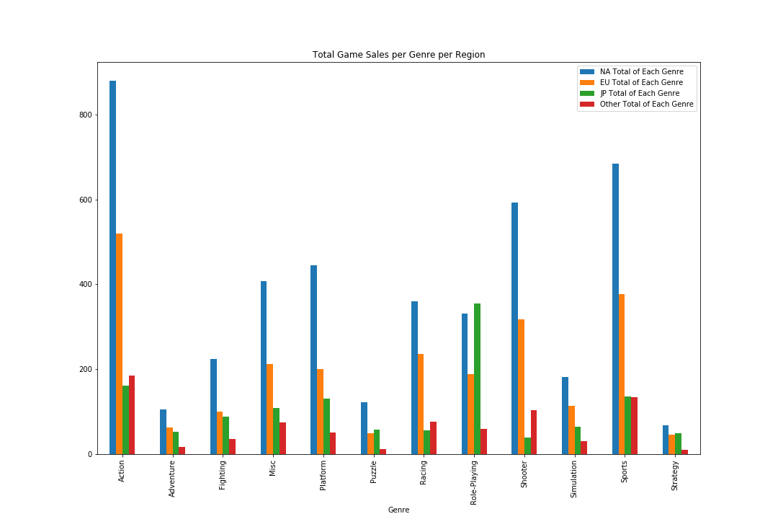
An Overview: Total Game Sales by Genre
Simple sum of each genre, so this table portrays the total sales of each genre in each region
It is evident that North America contains the lion’s share of video game sales in nearly every category
The only two genres not dominated by north american gamers are Strategy and Role_Playing
European preferences nearly mirror those of NA, however europeans buy less games
Action and sports games take up over 30% of the global market.

Slide 9
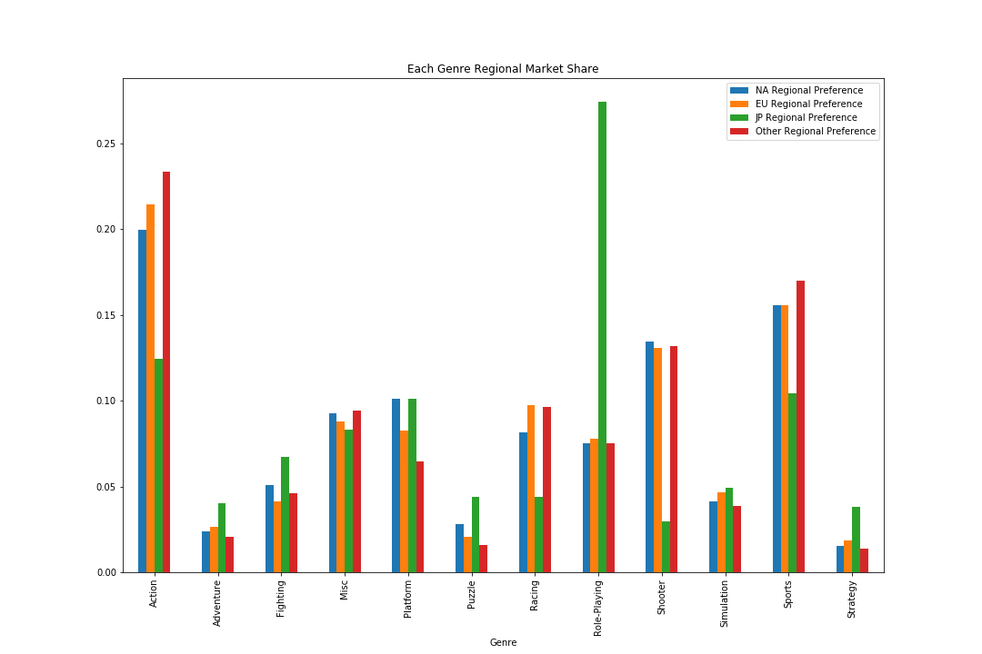
The Percentage Each Genre Takes of Regional Game Sales
With this rather cluttered plot, Japan sticks out from the rest with a massive preference towards Role-Playing/Strategy/puzzle games, less interest in action/racing games, and far lower interest in shooters comparatively.
Japan is very different in its preferences from the other regions
NA and EU have nearly identical preferences
Other region has similar preferences to NA and EU, but slightly prefers sports and action more

Slide 10
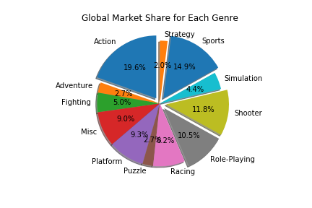
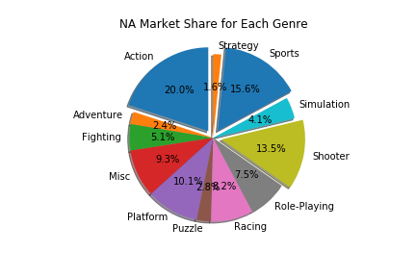
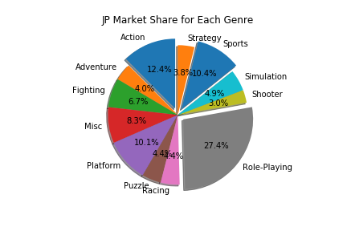
Each Region’s Genre Preference
The last graph but by individual regional markets and separated into individual pie chart for easier analysis
JP has a much large preference in Role Playing compared to global preferences, NA has a larger preference towards action, sports, and shooters... The data is skewed globally towards NA preferences

Slide 11
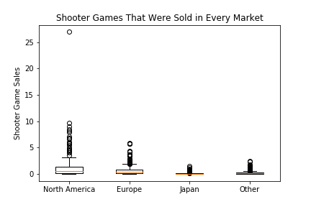
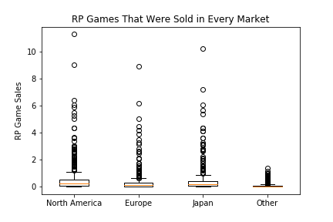


Genres with the
most deviation by region
This Data has only globally released games included, that is games with sales in every region, yet still the data is heavily skewed towards 0 sales, with mostly outliers making up the data exceeding 2-3 million copies shipped.
Most games, no matter the genre, are only moderately successful to unsuccessful.
3. If the game is released internationally it seems to have a greater chance of success.
4. North America is far more interested in shooters.

Slide 12
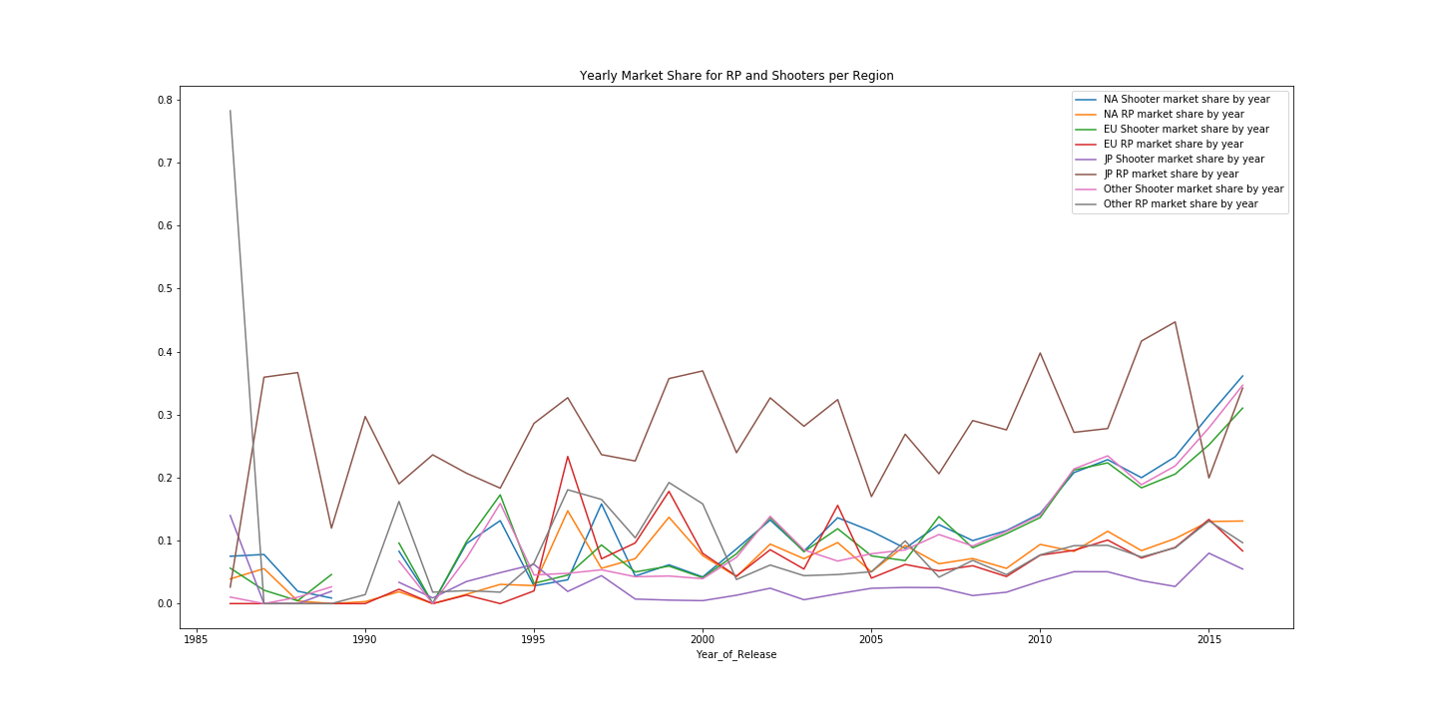
Yearly Market Share for RP and Shooter per Region

Slide 13
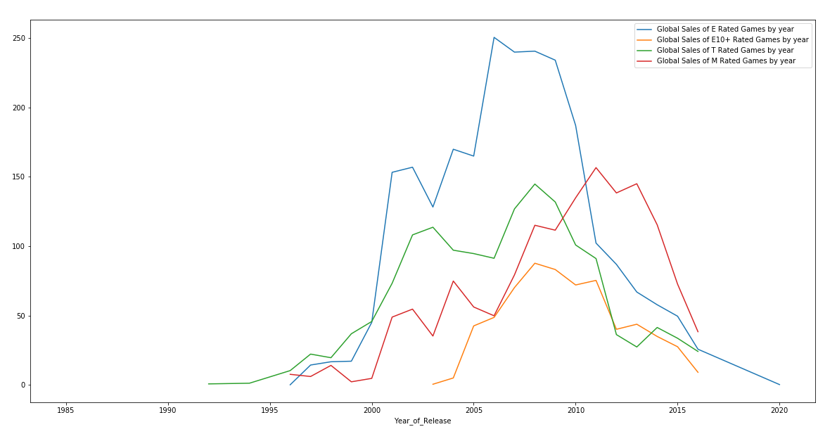
Global Sales by Rating, by year
Shows the steady rise in popularity of M rated games, a slow plateau in interest of teen games, and the dominance of E rated games
The Data seems to show that T and E10 games are decreasing in popularity, with many gamers now preferring M rated games
The data becomes inaccurate around 2011, although M rated games do manage to surpass all other ratings around this time

Slide 14
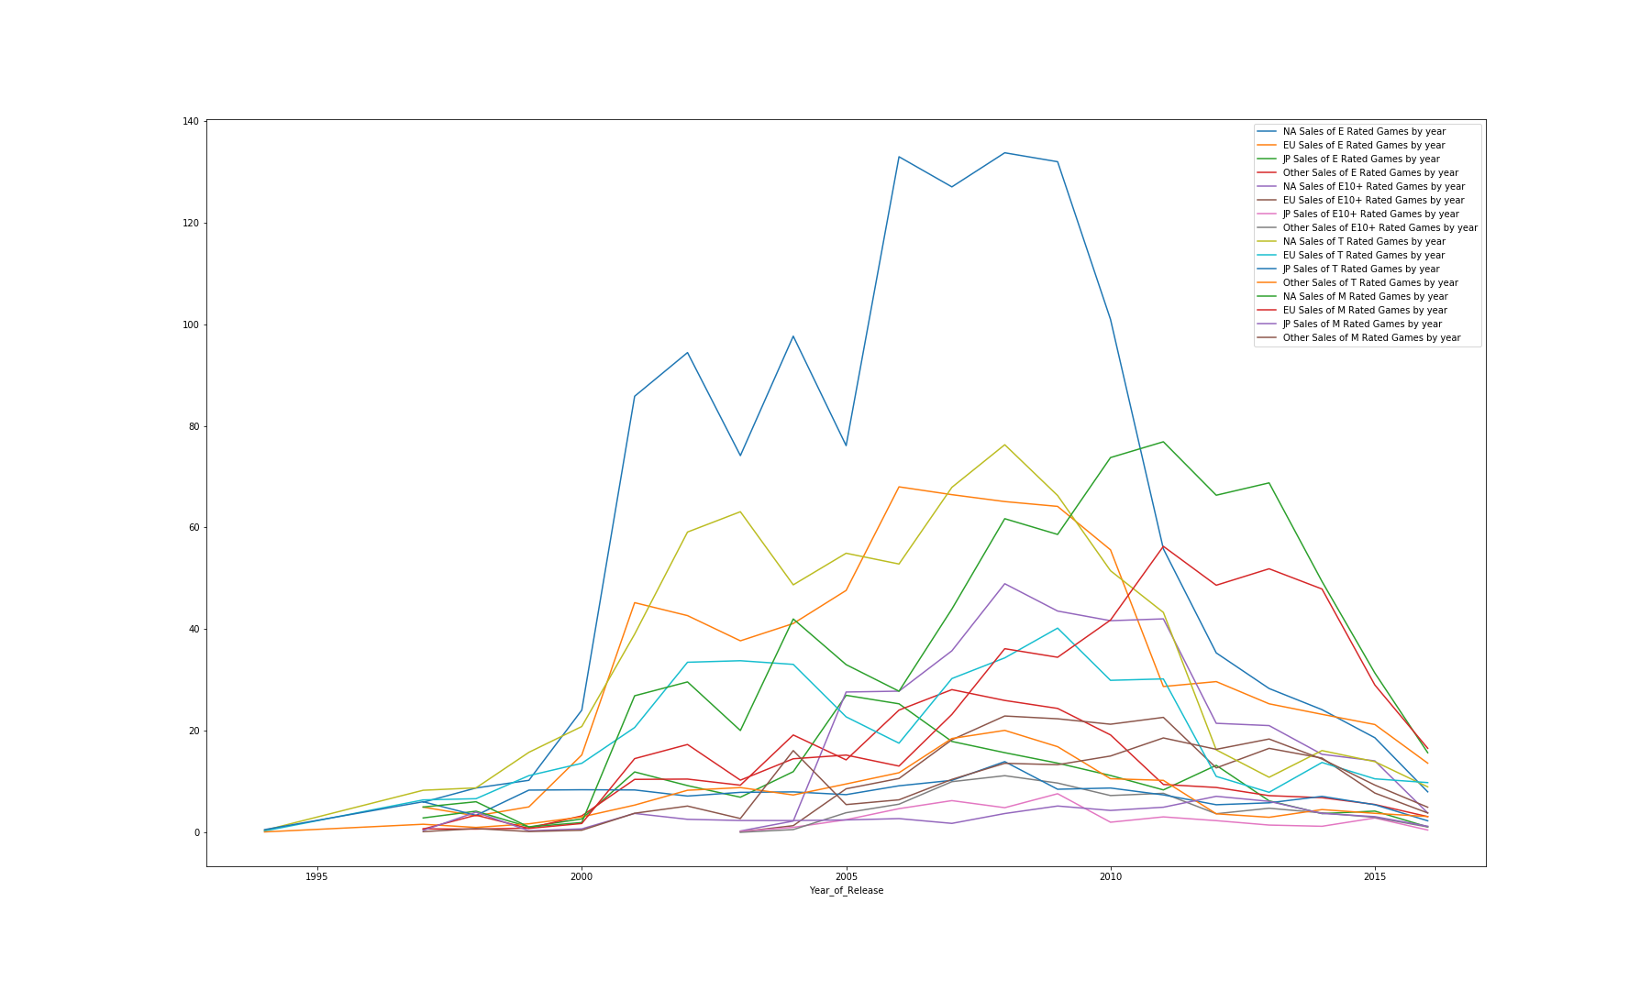
Regional Total Sales by Rating
Although difficult to view, this dataset acknowledges the regional preferences towards rating, with E dominating every market, especially North America
This graph also visualizes the rise in popularity of E rated games in Japan, overtaking T after around 2000, then the rise in M rated games after 2000 followed by a steep dropoff in 2008.
Other regions seem to prefer T and M games prior to around 2010, where in America, E rated games have been and still are king, which seems to be a contradiction to America’s preference towards fps and action games

Slide 15
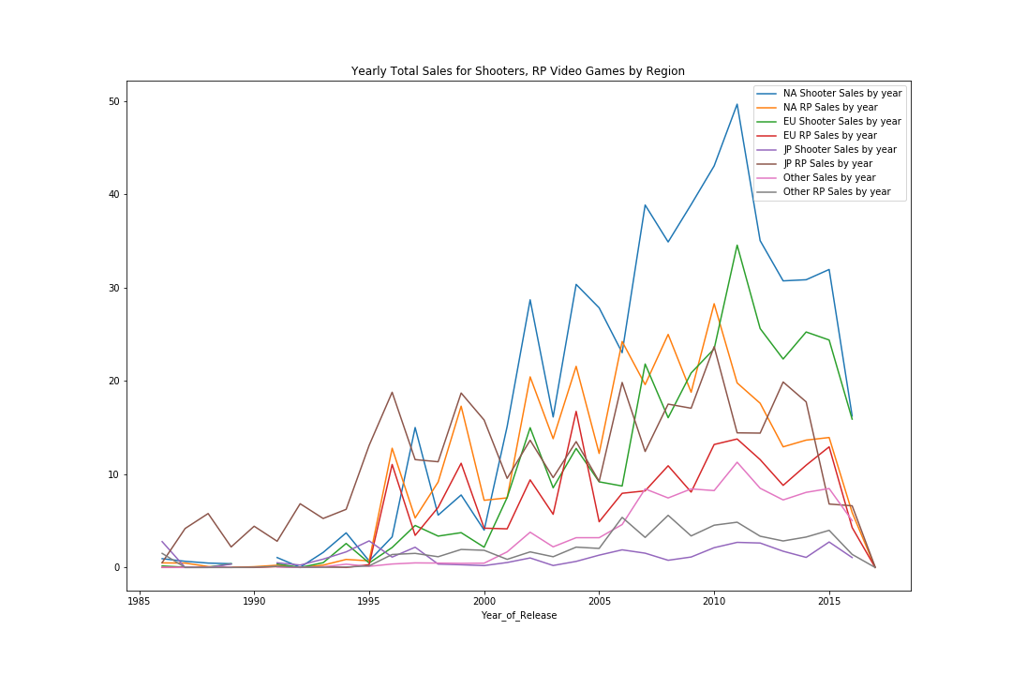
Shooter and RP Total Sales in Reference to Limitations
Simply shows the steady increase in Video Games shipped until around 2011, where mobile games and downloads begin to limit the data so that it no longer accurately reflects the total sales of every genre

Slide 16

Conclusion and Limitations of Genres/Ratings
With so much data, it is difficult to plot the entirety of the relationship between sales and genre.
Asia has very different preferences compared to EU and North America, and North America seems to prefer action/shooting games a bit more than EU.
An additional graph showing the count of each genre in each region revealed the most sold genres were also the most released genres in each region, showing that game publishers recognize regional preferences and release games accordingly
Because North America dominates total sales in almost every genre and rating, gamers in this region skew the global data towards the preferences of America.

Slide 17


PART.3 Global Sale VS. Critical Score Global Sale VS. User Score
Question
Did critical and user reviews correlate with the total sales of the game globally?

Slide 18
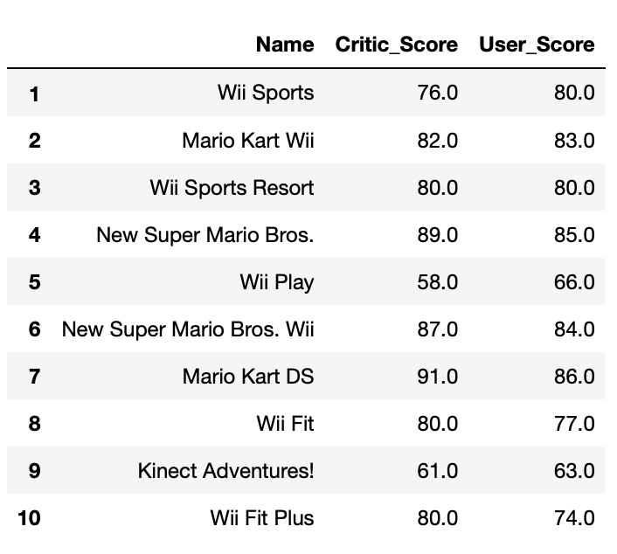
Sales, Critics, And User Score Of The Top10 Games
Top 10 Best Selling Games (Globally)

Slide 19
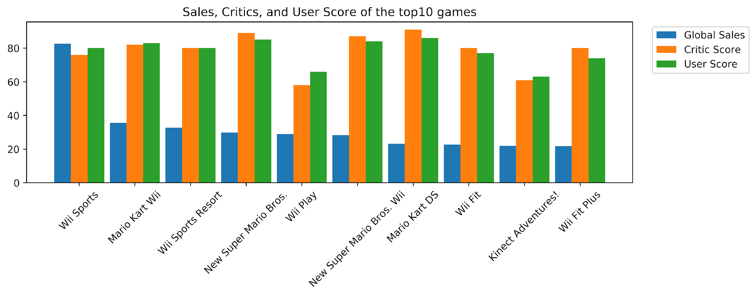

Sales, Critics, And User Score Of The Top10 Games
Results: No obvious data shows that the highest-selling games have the highest user ratings.

Slide 20
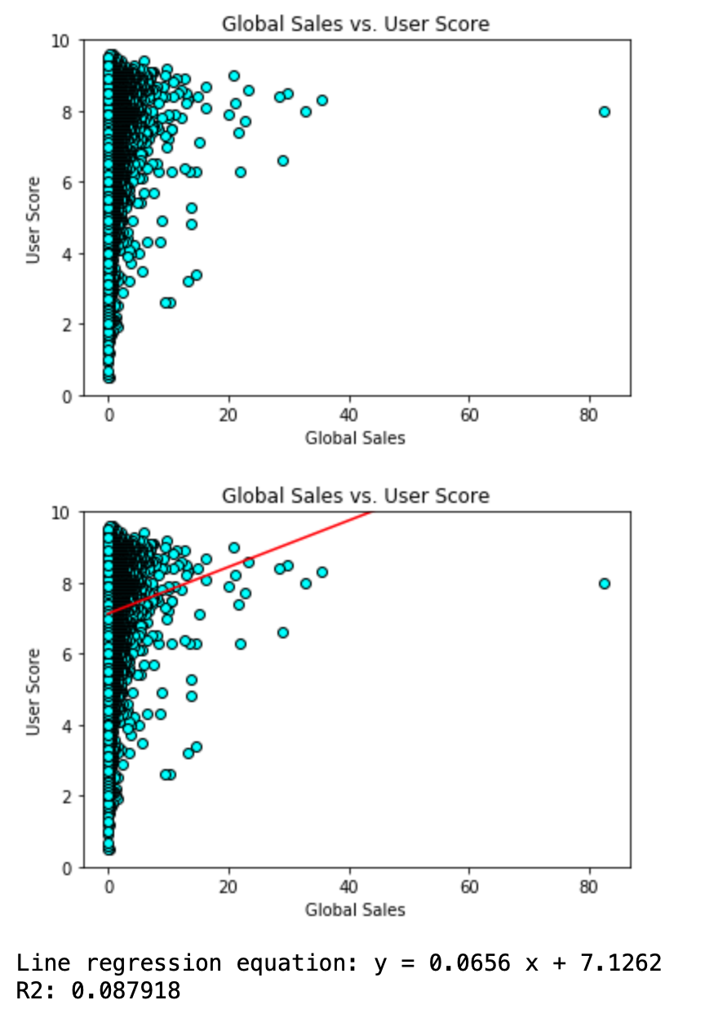

Global Sale Vs. User Score
Results:
Games with sales ranging from 0 to 10 (Unit: million pieces) have the widest rating range, with high and low user scores.
Games with sales ranging from 20 to 40 (Unit: million pieces), They all got a user score higher than 6.
The trend shows that it is not the highest-selling game has the highest user score.

Slide 21
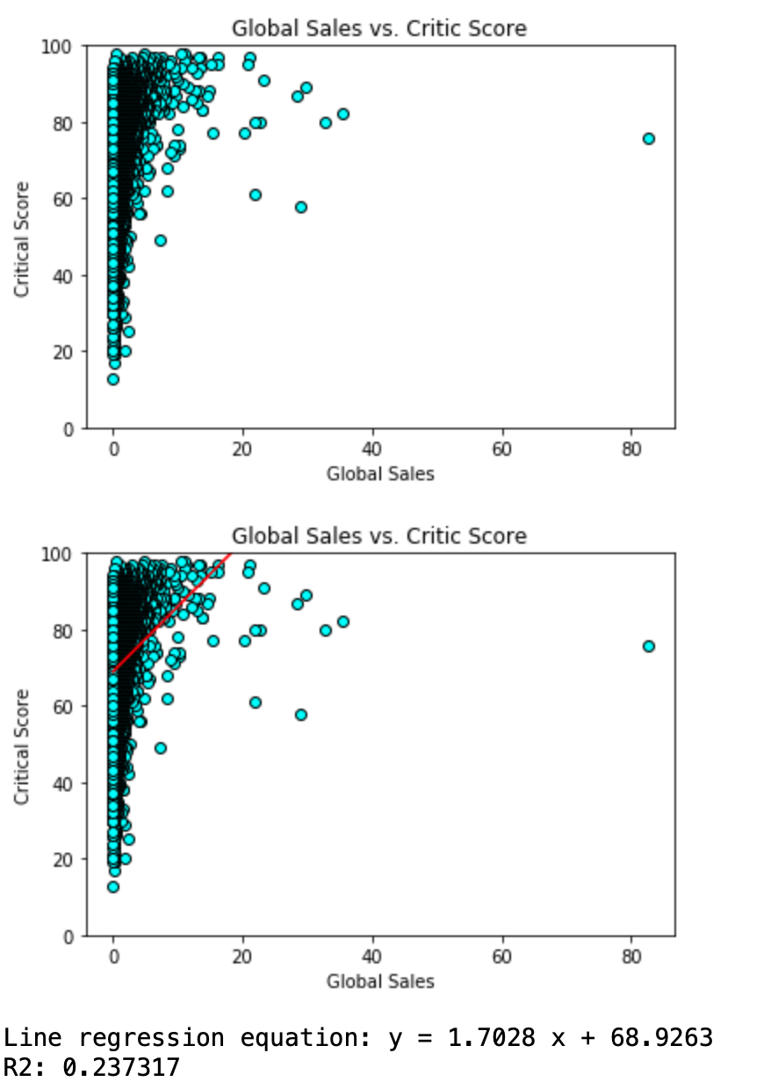
Global Sale Vs. Critical Score
Games with sales ranging from 0 to 10 (Unit: million pieces) have the widest rating range, with high and low critical scores.
Games with sales ranging from 20 to 40 (Unit: million pieces), They all got a critical score higher than 6.
The trend shows that it is not the highest-selling game has the highest critical score.

Slide 22
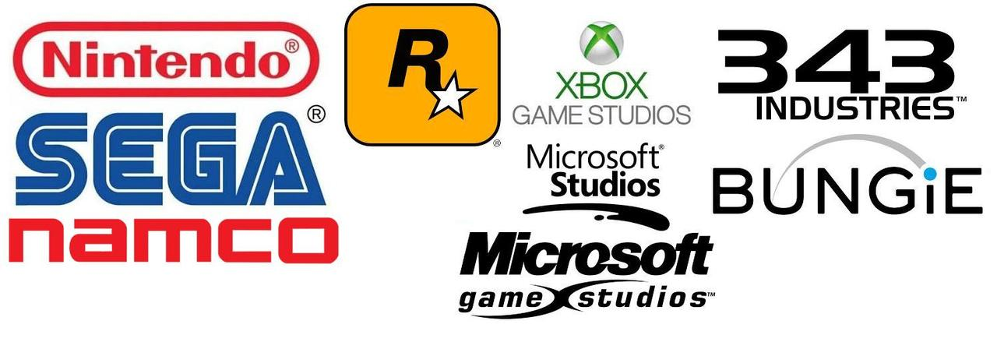
Box Plot: Group To Compare Relevance
Divide The Data Into Three Groups:
Top Sale Game : Global Sale > 10 Million Pieces
Fair Sale Game: Global Sale In Range 1 To10 Million Pieces
Poor Sale Game: Global Sale < 1 Million Pieces

Slide 23
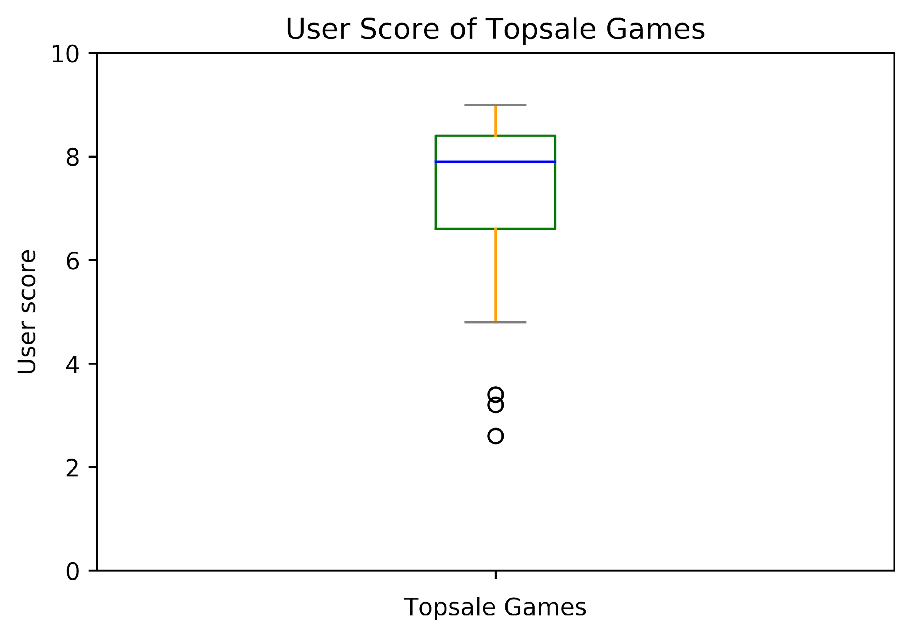
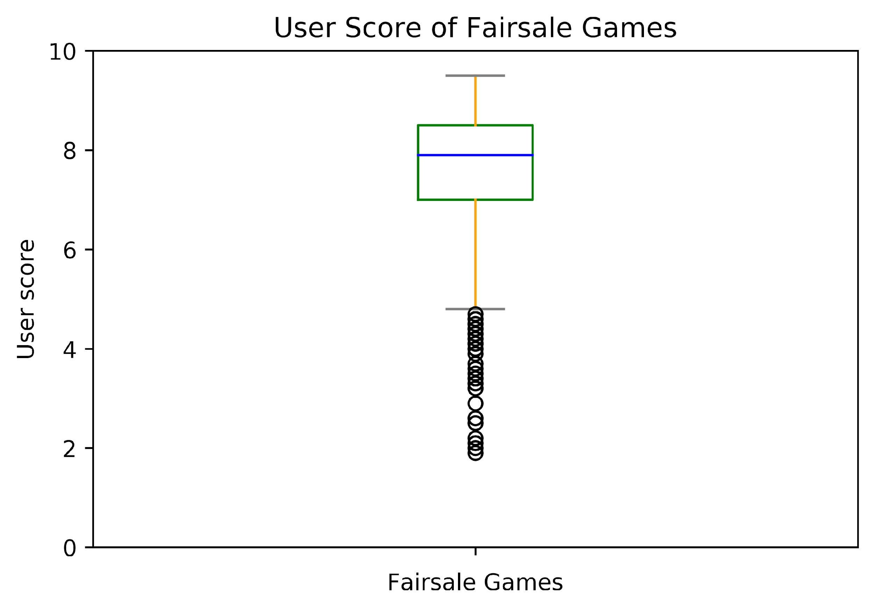
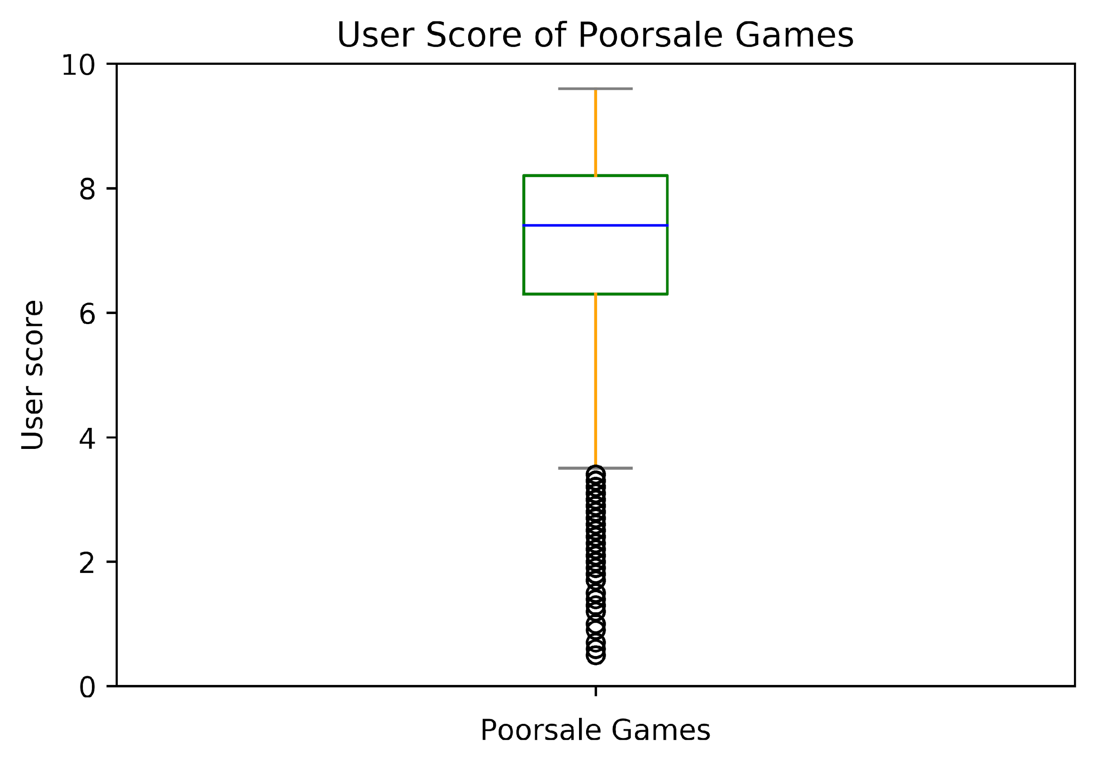
User Score Vs. Game Selling
The top sale game group has only few outliers, which means most of the top sale games have got high user scores, only few of them got user scores below average.
User scores of the top sale game group and the fair sale group are higher than the poor sale game group.

Slide 24
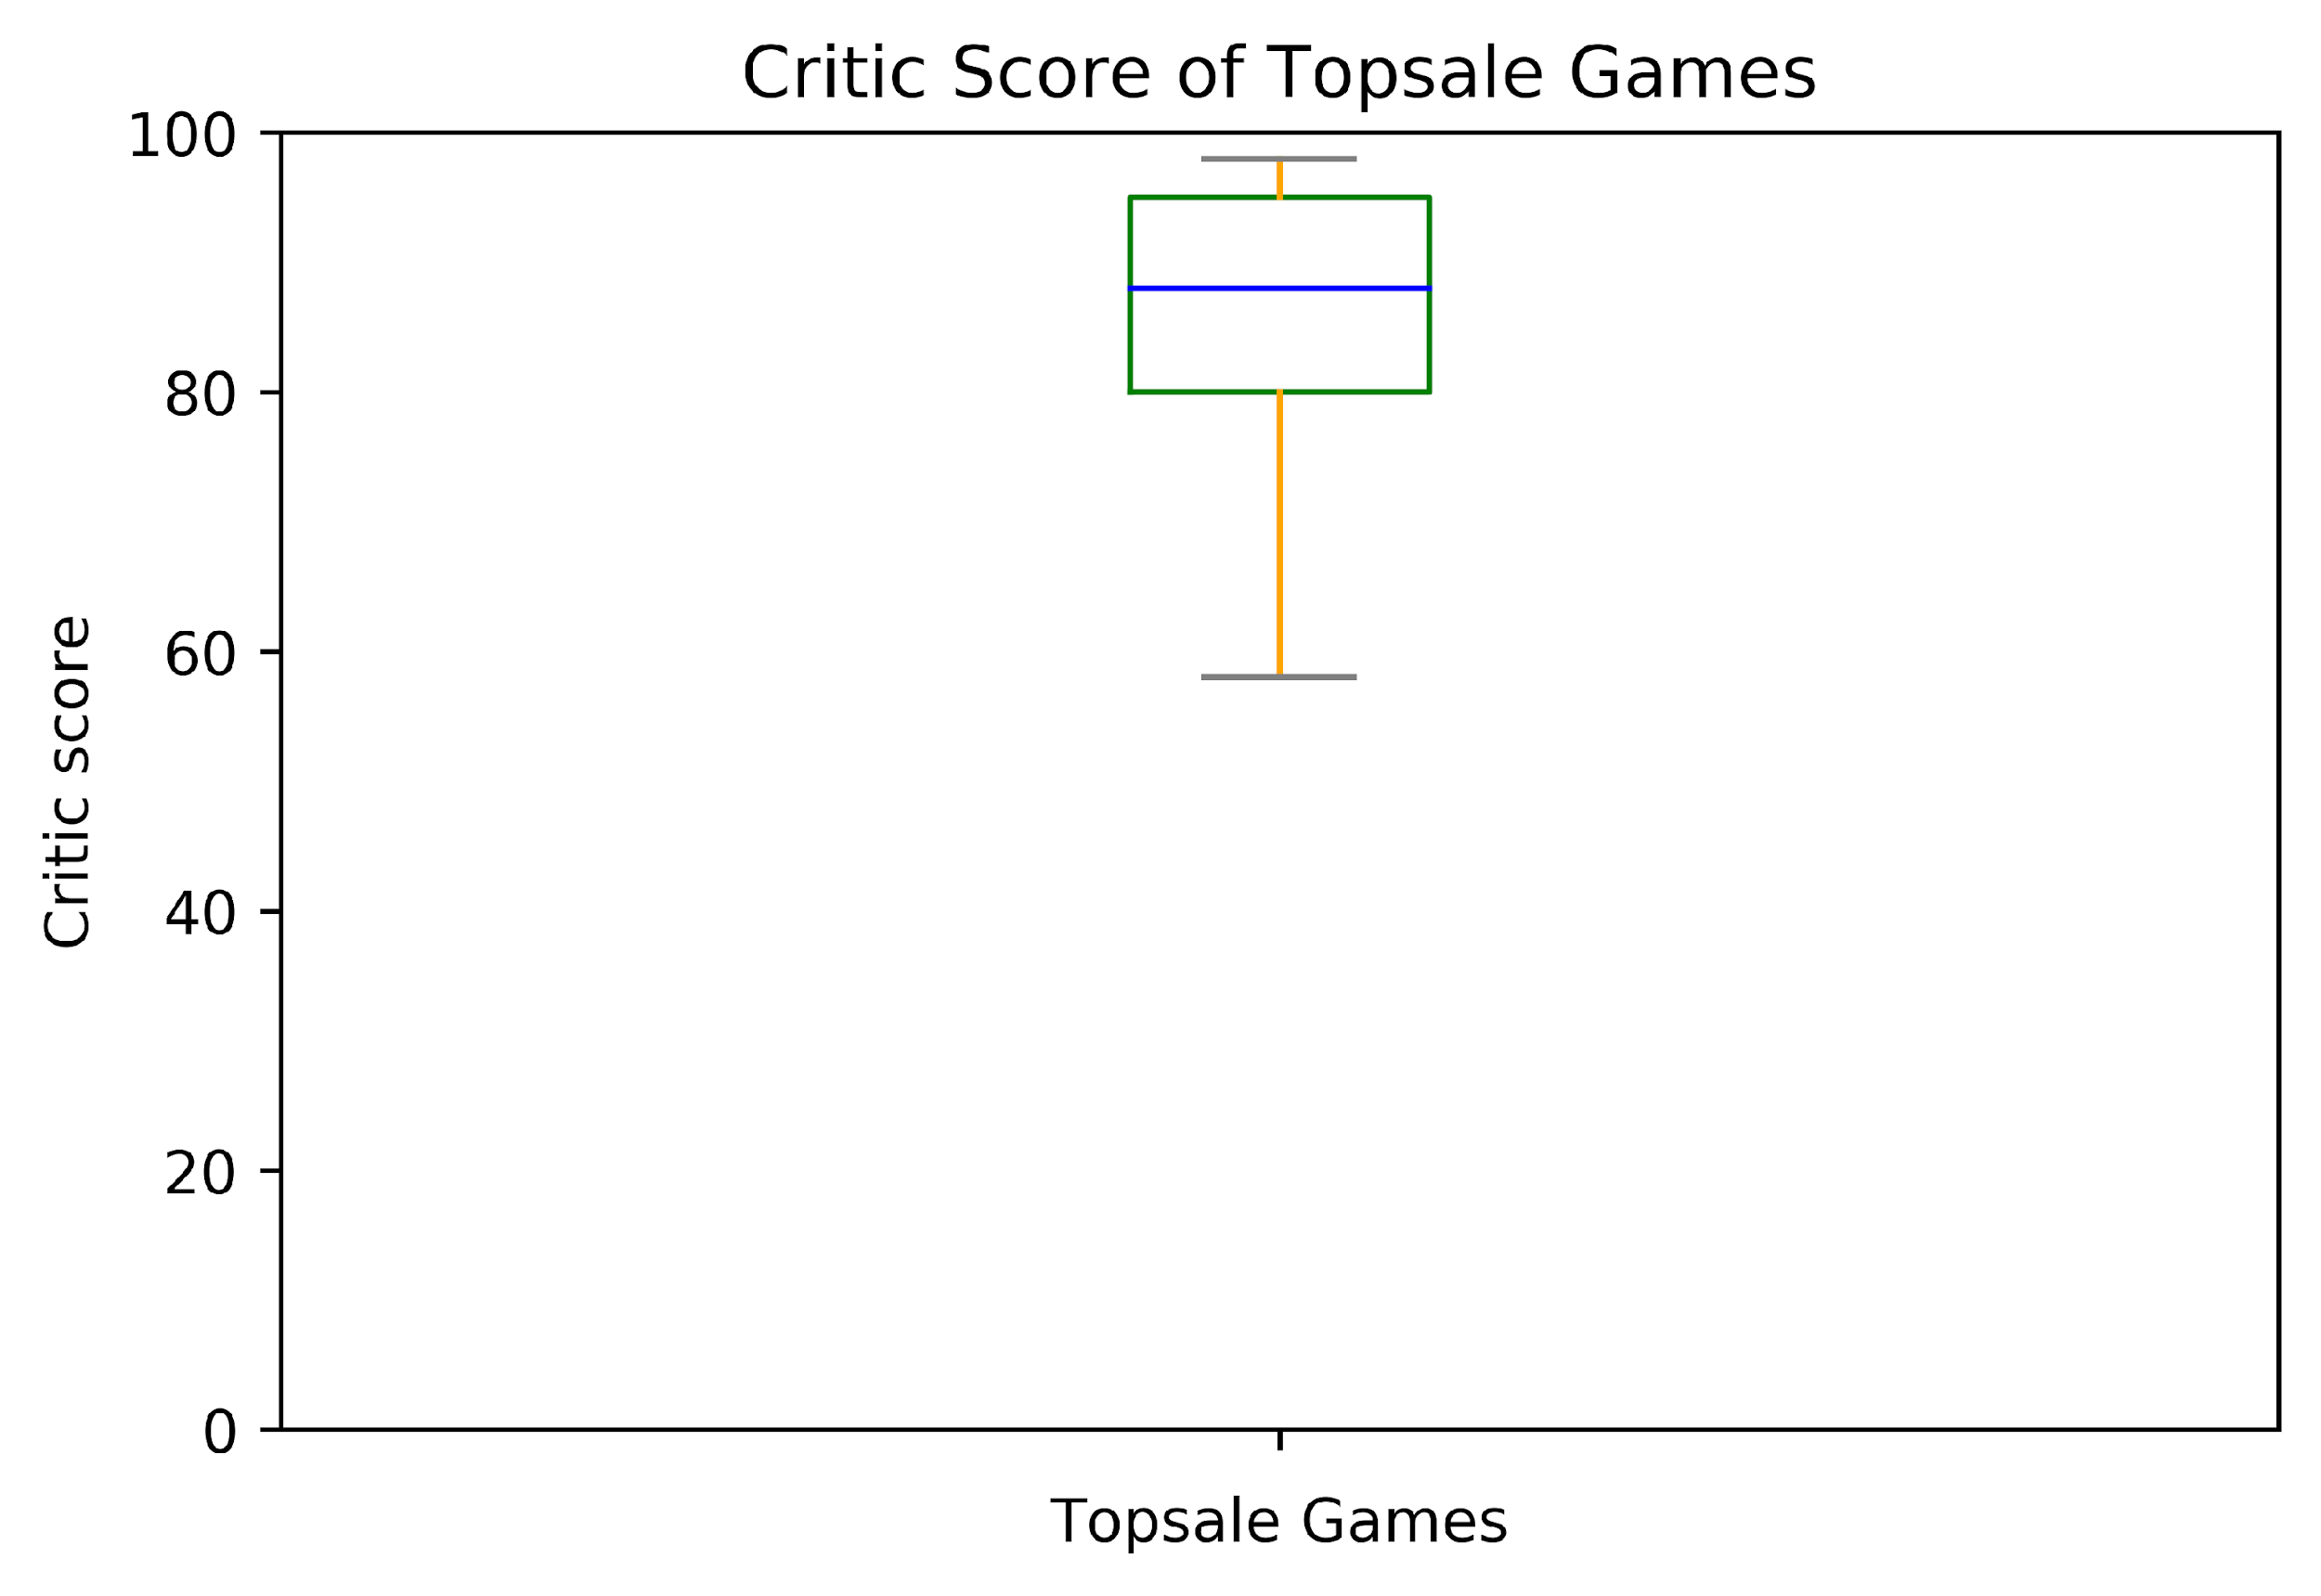
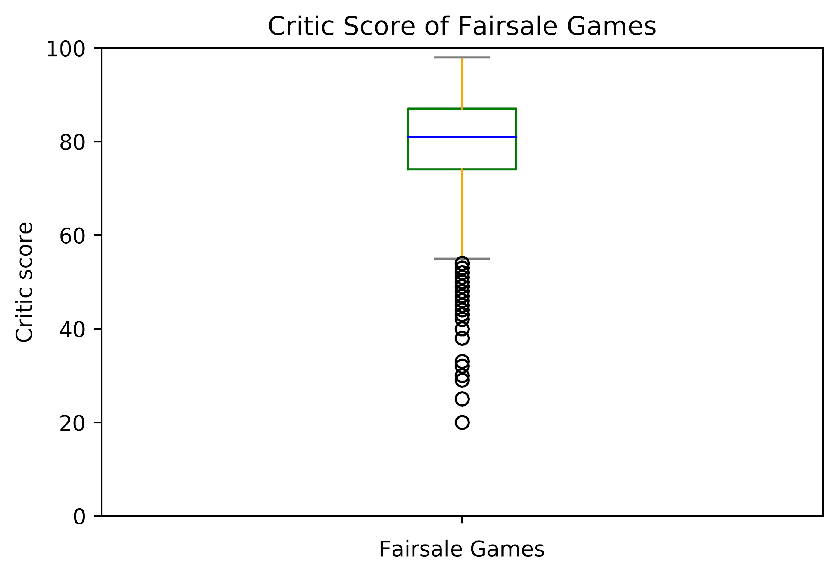
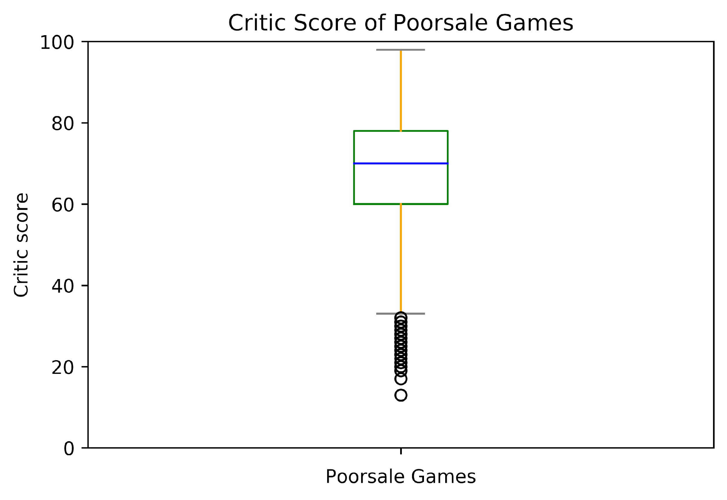
Critical Score Vs. Game Selling
The median of top sale games group is higher than the other two groups .
The top sale game group shows no outliers, which means both of the top sale games have got high critical scores.
Fair sale game group have higher critical score than poor sale game group, but a lot of outliers exist.

Slide 25
Conclusion
Quantities of each video games’ global selling and their user scores are positively related.
There is a strong correlation between global sale and critical reviews.
Global video game selling is proportional to the games’ critical reviews.
Top selling games have higher user scores and critical scores on average than lower selling games .
The highest-selling game has not got the highest critical score.
Although some games are not sold well, they have high user/critical score ratings.

Slide 26

Limitation
Not enough game players participate in scoring and rating.
Lack of detailed information about rating players, for example, players’ age ,gender ,and occupation etc.
Existence of missing data.

Slide 27
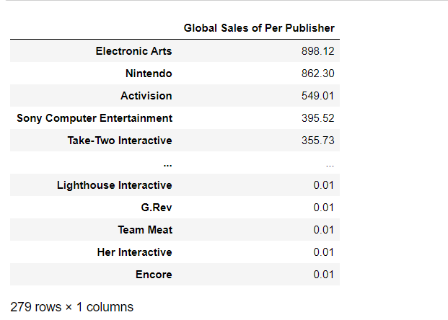
# Group Project Part 4
# Total sales of each major publisher
Clean game_data
Get total sales of each publisher globally by year
Use .sort_values to rank

Slide 28
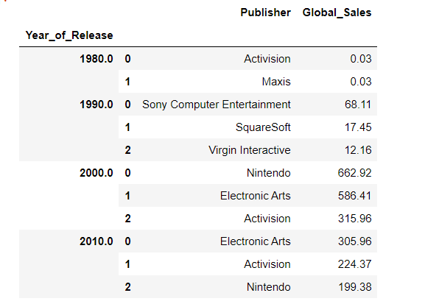
# Group Project Part 4
Create bins and count for games that have been published for each decade
Use columns = [y.Publisher, (y.Year_of_Release//10)*10] to create two columns and year gaps
Create a lambda x: x[columns].sort_values(by ='Global_Sales’) to sort the maximum Global Sales value in each decade

Slide 29
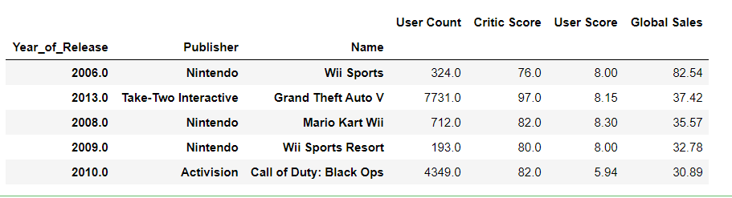
# Group Project Part 4
# The most profitable & popular games overall
Define a function called analysis
Include 4 keys(columns) and show the new data frame
Use n.largest to nest down the top 5 games

Slide 30
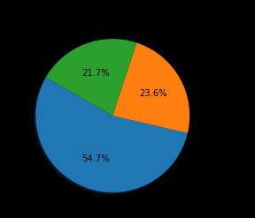
My question
# Top 3 most profitable games (pie chart) overall
This pie chart regarding three video games overall that have the most global sales does not match the games in ‘gamedata.’

